Slide 1
Tobacco
The truth about tobacco
“We don’t smoke that s***, we just sell it. We reserve the right to smoke for the young, the black, the poor, and the stupid.”
– R.J. Reynolds CEO of second largest tobacco company

Slide 2
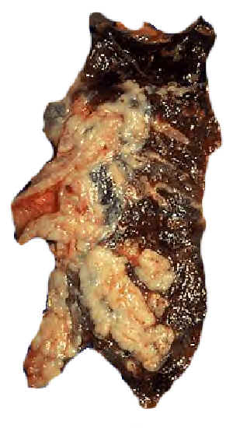
The basics
One thousand Americans stop smoking every day –
by dying. ~Author Unknown
There is no safe level of exposure to tobacco smoke. Even the occasional cigarette or secondhand smoke is harmful.
Damage from tobacco smoke is immediate. The chemicals in tobacco reach your lungs quickly, and are carried through your blood stream to every organ in your body.

Slide 3
The basics
Cigarettes are designed for addiction, and they work. Only 4.7% of smokers successfully quit each year.
Cigarette smoke contains over 4,800 chemicals. 69 are known to cause cancer. The rest are just really bad for you.
There is no safe cigarette. Evidence indicates that "light" and "low-tar" cigarettes are just as bad as their "normal" counterparts

Slide 4
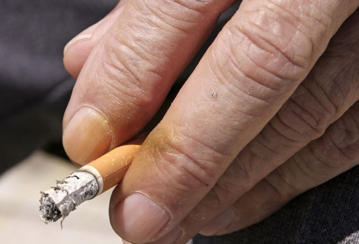
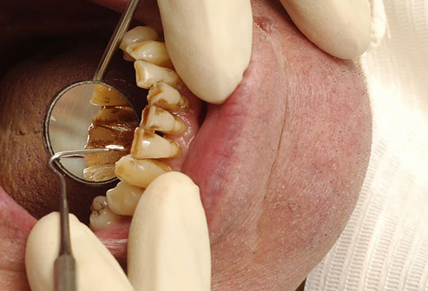
the health effects
Tobacco smoke damages blood vessels and thickens your blood, making it more likely to clot, leading to heart attacks, strokes, and even sudden death.
Smoking tobacco has many highly-noticeable effects, such as the infamous "smoker's breath", tar-stained teeth, yellowed fingertips, premature facial wrinkles, and a lingering stench.
Can also cause hair loss

Slide 5
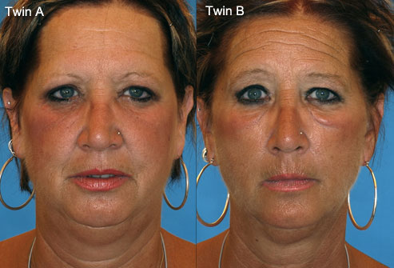
Examples of effects on the skin

Slide 6
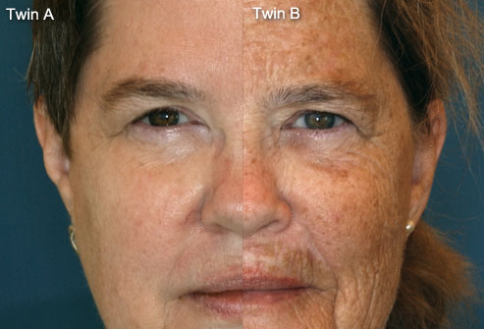
Examples of effects on the skin

Slide 7
The health effects
Tobacco smoke inflames the delicate lining of your lungs, and can cause permanent damage, emphysema, and chronic bronchitis.
Tobacco smoke weakens your immune system, making it harder to fight off infectious disease.
The toxicants and chemicals in tobacco smoke damage your DNA, which can lead to cancer.
Smoking cigarettes causes impaired lung growth during childhood and adolescence
Puts children at higher risk for illnesses and infection
“The base of our business is the high school student”
Lorillard area sales manager Ted L. Achey.
“Students are tremendously loyal. If you catch them, they’ll stick with you like glue.”
- Philip Morris

Slide 8
The brain effects
Nicotine reaches your brain within 10 seconds of inhalation.
The powerful addicting elements of tobacco products affect multiple types of nicotine receptors in the brain.
Adolescents who smoke show impaired memory and other brain functions.
Kids and young adults are more susceptible to nicotine, and are more easily addicted than adults.
The neurotoxic effects of nicotine are more severe for adolescent and their developing brains.
Smoking is "more addictive" to younger brains.
In animal trials, nicotine exposure during the brain's growth spurt had long term consequences for brain development.

Slide 9
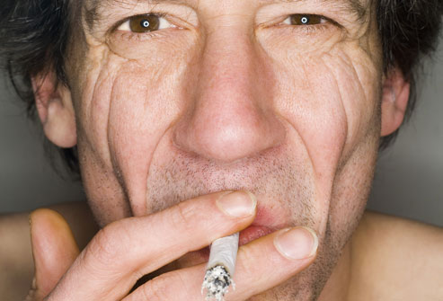
3 main chemicals
Nicotine: a poisonous drug stimulant that acts on the adrenal glands, heart and brain.
Increases heart rate and blood pressure
Is very addictive
Tar: a thick, dark, sticky liquid added for “flavor”
Contains hundreds of carcinogens (cause cancer)
Coats cilia, impairing lung function
Carbon Monoxide: a colorless, odorless, poisonous gas.
Prevents hemoglobin from carrying oxygen to the cells

Slide 10
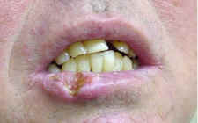
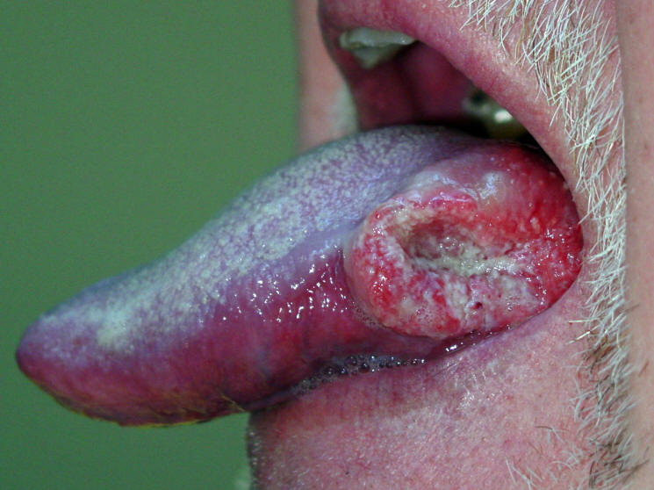
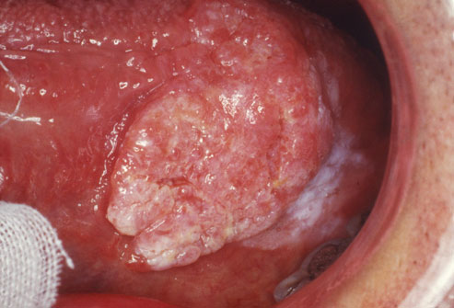
Chewing tobacco
Delays healing of wounds
Increases gum and tooth decay
Risk of oral cancers is 50% times greater
Increases chance of lip cancer
Leukoplakia (a callus in the mouth) – a thick white, leathery patch. Pre-cancerous

Slide 11
The stats
Every year, tobacco kills more Americans than AIDS, alcohol, car accidents, murders, suicides, drugs, and fires. Combined.
Nearly 1/3 of all cancer deaths every year are linked to smoking.
The tobacco industry spends about $12.5 billion on advertising and promotions every year.
In 2006 alone, Americans spent an estimated $90 billion on tobacco products. That's over $34 million a day.
Cigarette companies advertised "light" cigarettes as less harmful for years, even though they have since been found to deliver the same levels of tar and nicotine as "normal" cigarettes.
A tobacco company once gave $125,000 worth of food to a charity (according to an estimate by the Wall Street Journal), then turned around and spent $22 million telling people about it.

Slide 12
Quitting -More than 70% of smokers want to quit
Don’t smoke any cigarettes.
Each cigarette you smoke damages your lungs, your blood vessels, and cells throughout your body.
Even occasional smoking is harmful.
Write down why you want to quit. Do you want to—
Feel in control of your life?
Have better health?
Set a good example?
Protect your family from breathing other people’s smoke?
Really wanting to quit smoking is very important to how much success you will have in quitting.

Slide 13
Quitting – cont.
Know that it will take commitment and effort to quit smoking.
Nearly all smokers have some feelings of nicotine withdrawal when they try to quit. Nicotine is addictive. Knowing this will help you deal with withdrawal symptoms that can occur, such as bad moods and really wanting to smoke.
There are many ways smokers quit
Nicotine Replacement
Medications (simulate dopamine)
Self Management strategies (identify triggers, avoid tempting situations and manage feelings with response substitutions)

