Slide 1
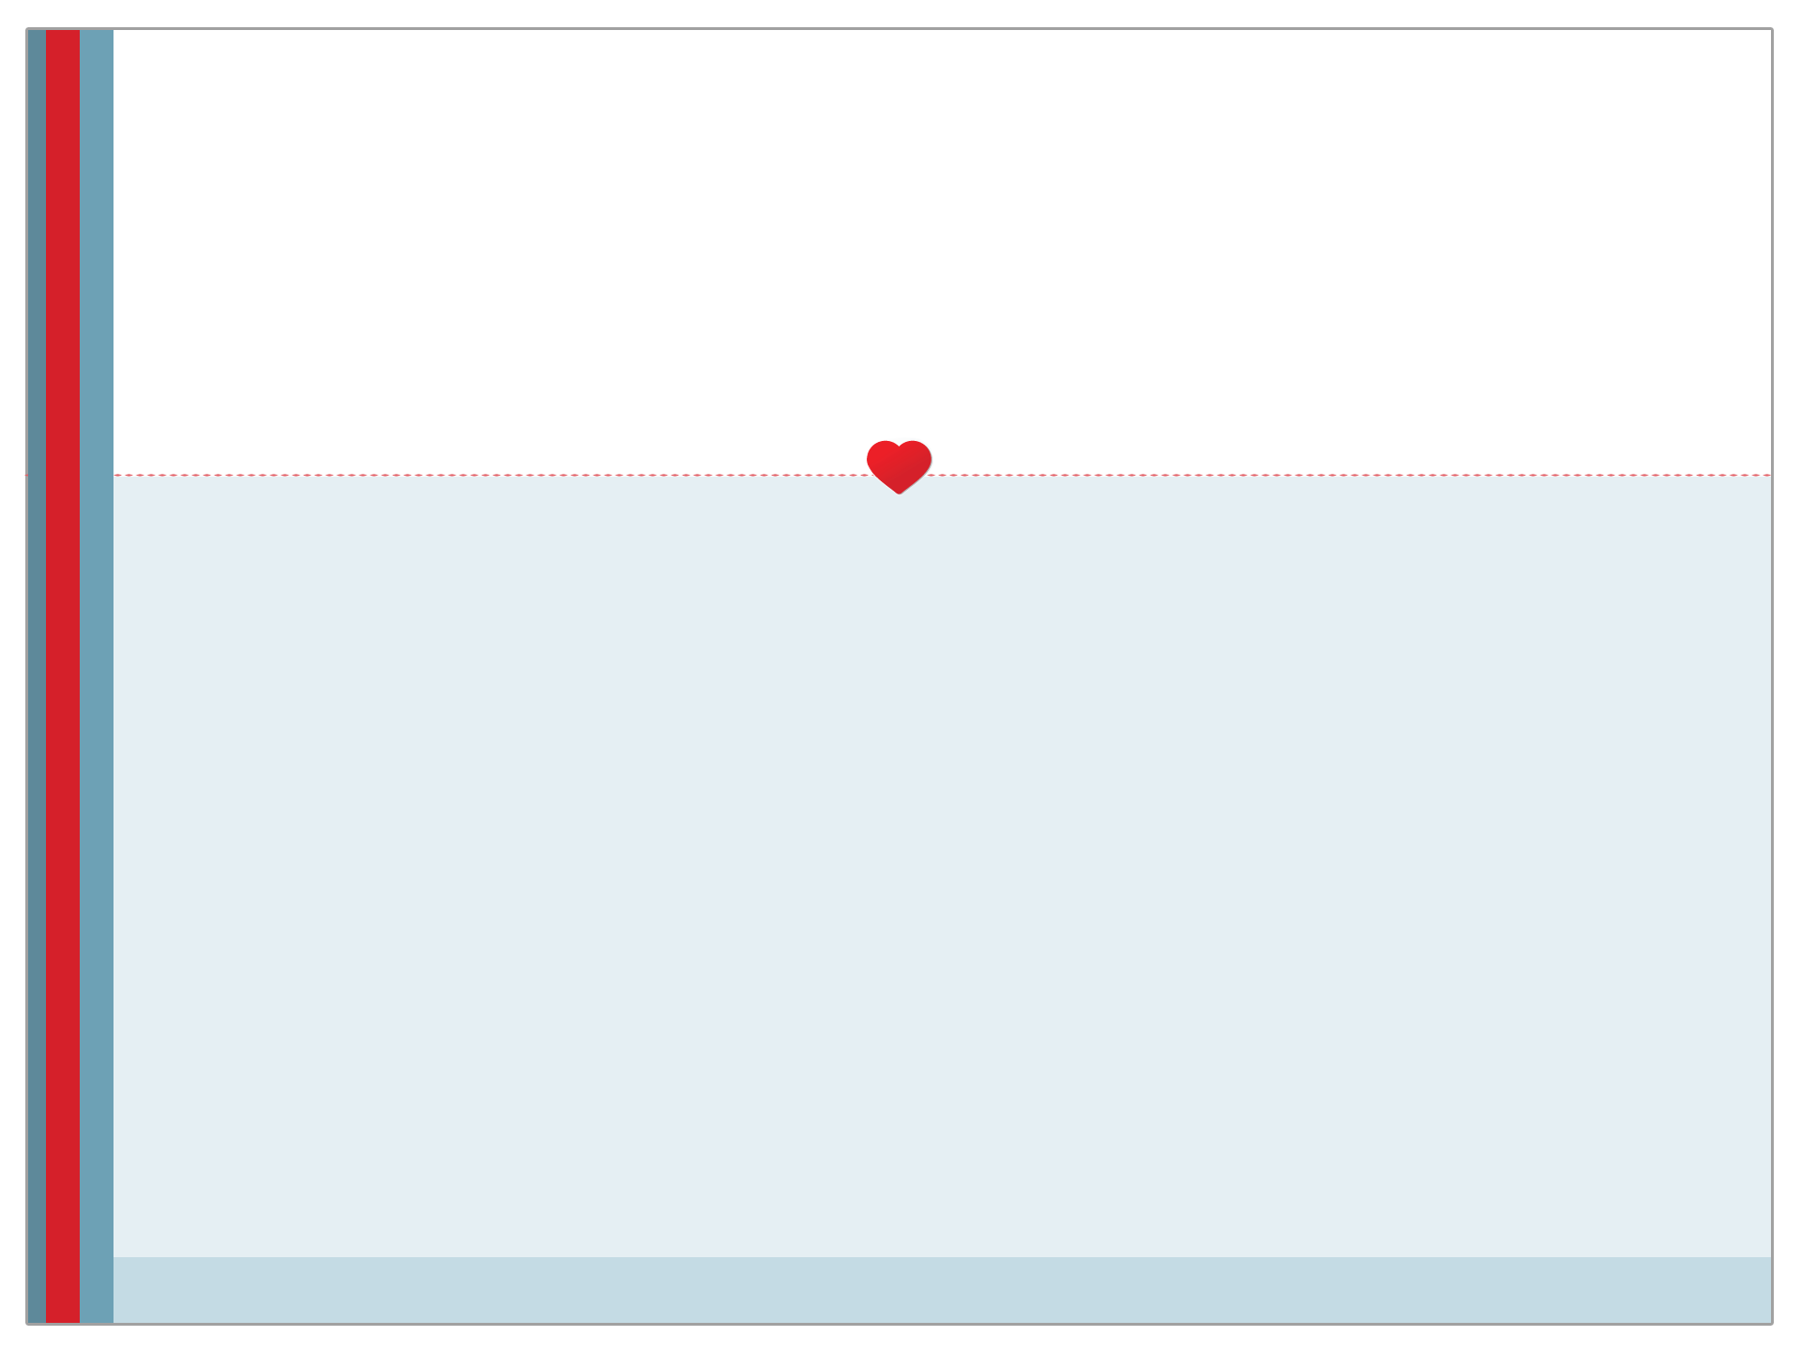
Stress Management

Slide 2
Importance of Stress Management
Stress is something that everyone experiences, so learning how to cope with its effects is something that everyone needs to master for their own physical and psychological well-being.
Those who don’t learn and use appropriate stress-management techniques can experience a variety of negative effects, including physical illness, psychological illness, damaged personal relationships, poor productivity and more.
Stress is a top health concern for U.S. teens between 9th and 12th grade, psychologists say that if they don’t learn healthy ways to manage that stress now, it could have serious long-term health implications – American Psychological Association.

Slide 3
Learning to Manage Stress
Effective stress management involves the following:
Learning to recognize the signs that you are experiencing stress
Recognizing the circumstances that trigger stress reactions in you
Applying stress management techniques to help you cope

Slide 4
Recognizing the Signs of Stress
Stress is both a psychological and physiological response to change.
It does not manifest itself the same way in everyone.
Some people do not eat enough when they are stressed, while others binge-eat.
Some develop insomnia during times of stress, while others sleep excessively.
When your “ordinary” behaviors and responses change significantly as a result of life circumstances, chances are that you are experiencing stress.

Slide 5
4 Main Sources of Stress
Mental: Own thoughts is the #1 source for stress
Social: Parent, peers
Environmental: Noise background, construction, weather
Physiological: not eating breakfast, lack of sleep

Slide 6
Two Types of Stress
EUSTRESS: good/positive stress, adrenaline is released.
Working out – causes positive change
DISTRESS: bad/negative stress, worrying

Slide 7
3 Ways to Deal/Cope
Avoid the stressor
Alter your perception
Prepare to deal with it

Slide 8
How Does the Body React
General Adaptation Syndrome GAS:
Body’s response to stress
Alarm: Fight or Flight response, adrenaline released into the bloodstream
Resistance: Body attempts to regain balance
Homeostasis (body tries to maintain internal balance)
Exhaustion: harmful body changes, lowers your bodies resistance to disease/illness
* Key is to reach relaxation before exhaustion

Slide 9
Stress Can Make You Sick
60% to 80% of all physical and mental disorders are related to stress.
Not all are caused by stress, but many are made worse by stress.
Some other disorders/diseases made worse by stress:
Colds/flu
Headaches
Backaches
TMJ syndrome
Heart disease
High blood pressure
Chronic Fatigue
Depression
Asthma

Slide 10
Common Signs of Stress
Pounding heart rate
Shaking
Inability to make decisions
Inability to act
Lack of focus
Hyperactivity
Appetite changes
Sleep pattern changes
Many other possible signs

Slide 11
Potential Stress Triggers
There are many potential triggers for stress, including the following:
Increased responsibility
Major life changes (marriage, divorce, relationship troubles, childbirth, death of loved ones, etc.)
Relocation
Financial pressures
Job changes
Natural and man-made disasters
Many other factors

Slide 12
10 Stress Management Techniques
1. Relaxation Techniques
Meditation
Deep Breathing
Visualization Activities
Aromatherapy
Massage Therapy

Slide 13
10 Stress Management Techniques
2. Exercise
Aerobic activities
Running
Swimming
Zumba
Anaerobic activities
Walking
Stretching
Yoga

Slide 14
10 Stress Management Techniques
3. Nutrition
Eat a balanced diet.
Stay hydrated with plenty of water.
Avoid processed foods.
Reduce caffeine consumption.
Avoid alcohol.
Take appropriate nutritional supplements.

Slide 15
10 Stress Management Techniques
4. Sufficient Rest
Get plenty of sleep.
Take a few short breaks throughout the day.
Allow your mind to rest periodically.

Slide 16
10 Stress Management Techniques
5. Goal Setting
Break major projects/tasks down into achievable goals.
Set milestones for goal achievement.
Track progress toward goal accomplishment.
Reward yourself for progress.

Slide 17
10 Stress Management Techniques
6. Journaling
Keeping a journal is a good way to keep stressors from building up inside yourself.
Journaling also provides a way to make it easier to recognize circumstances and patterns that lead to stress reactions.
Writing down stressors can be a great step toward learning how to manage them effectively.

Slide 18
10 Stress Management Techniques
7. Proactive Communication
Express your feelings to those who are involved in the stressful circumstances in your life.
Discuss the circumstances you are facing with trusted friends and confidantes.

Slide 19
10 Stress Management Techniques
8. Seek Counseling or Therapy
Seeking professional assistance when needed is a sign of strength.
Working with a qualified therapist, counselor or other qualified mental health professional can be one of the best ways to learn how to deal with stress.

Slide 20
10 Stress Management Techniques
9. Deal with Circumstances
Engaging in avoidance behavior is not an effective technique for stress management.
Ignoring problems or pretending that things are fine when they are not only leads to greater stress in the long run.
Managing stress effectively requires actually dealing with it and working through it.

Slide 21
10 Stress Management Techniques
10. Apply Effective Time Management Skills
Take the time to get organized.
Prioritize your to-do list.
Learn to delegate.
Leave time for yourself in your schedule.
Learn how to say “no” to stress-inducing requests that are not essential.

Slide 22
Stress Management That Works for You
Finding the stress management techniques that work effectively for you in the stressful situations that arise throughout your life can be a powerful resource for health promotion.
Be mindful of when you experience stress, how it affects you and what actions best allow you to cope with its effects.

Slide 23
Sources
Mayo Clinic http://www.mayoclinic.com/health/stress-management/MY00435
RD.com http://www.rd.com/health/wellness/37-stress-management-tips/
Web MD http://www.webmd.com/balance/guide/tips-to-control-stress#mainContentContainer_area

