Slide 1
Newsletters

Slide 2
Basics
Cost-effective means of communicating.
One of the most common means of communicating information and ideas to other people.
Successful newsletters contain consistent elements in every issue.
Elements divide the newsletter into organized sections to help the reader understand the text, as well as to entice the reader to continue reading.
Reproduced on a regular basis, whether monthly, bimonthly or quarterly.

Slide 3
basics
Published by:
Individuals
Associations
Cubs
Churches
Schools
Businesses
Consultants
Service organizations
Political organizations
Other establishments from all over the world.

Slide 4
Columns
Single column newsletters are easy to produce because the articles simply follow each other.
If you don’t have a lot of time this format is the one to use.
Simplest to design and work with because it allows you to make changes and additions easily.

Slide 5
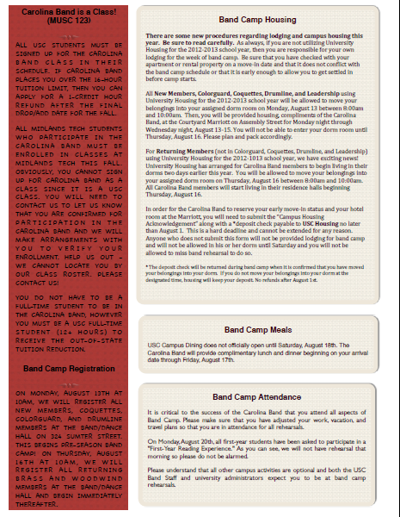
COLUMNS
Two-Column is most frequently used.
Gives a formal look
Justified text
Avoid tombstoning - occurs when two or more headlines or subheads appear horizontally adjacent to each other on the same line.
The term tombstoning comes from the side-by-side arrangement of tombstones in a cemetery. “Dead Bugs” “Drink Wine”

Slide 6
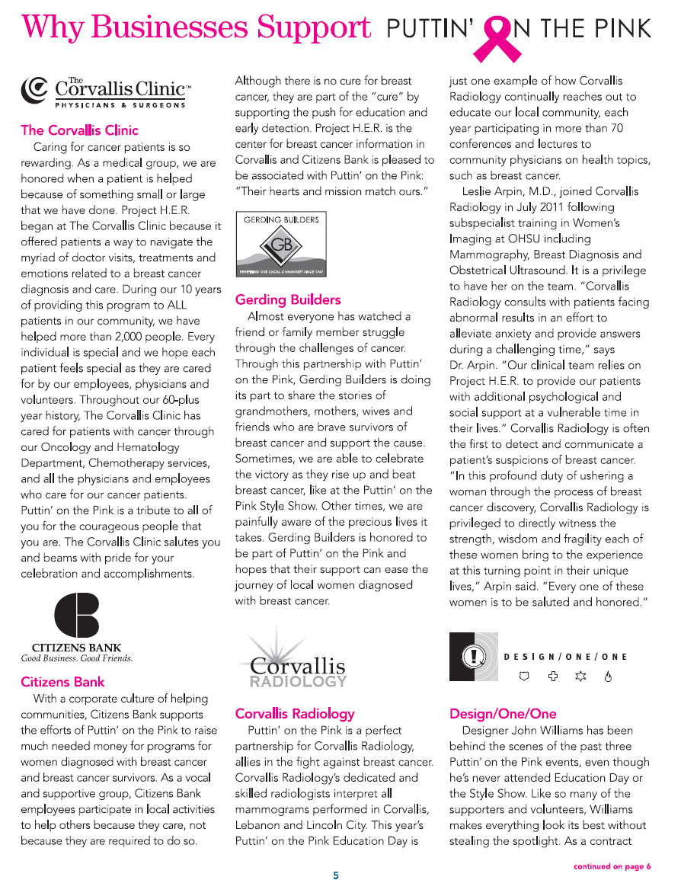
Columns
Three-Column format is more flexible for adding interesting design elements.
Four-Column format is even more flexible. More time may be spent in putting this newsletter layout together though.

Slide 7
How it looks
Should be professional and authoritative even if your design in slight and fun.
The more professional your newsletter, the more professional your organization appears.
Credibility earns business.
Layout should be consistent, same styles, colors, lines and page number placement should be used on every page.
Reflection of organization’s identity, so make use of your logo and colors.

Slide 8
Audience
Attract broader audience by:
Including three or four articles on the front page and finishing the stories inside.
Include a table of contents and highlight feature articles with teasers.
White space is your friend, it helps separate elements.
Stand out from others by using images of authors in action instead of mug shots.

Slide 9
Purpose
Before creating you must consider the target audience and the object for providing the information: to sell, inform, explain, announce, educate? The purpose?
What image do you want to project?
Consider frequency of distribution.
Use restraint and consider the appropriateness of images and design elements.
View in Reading Layout View.
Consider cost of materials, printing and distribution

Slide 10
Design
Determine underlying column layout and keep consistent.
Create appropriate margin and column widths (two-sided or facing pages).
Adjust character spacing using the Font dialog box. Usually applied to headlines and subheads.
Apply dot leaders to table of contents.

Slide 11
Design
Contrast: Avoid elements on the page that are merely similar.
Repetition: Repeat visual elements of the design throughout the piece. You can repeat colors, shapes, textures, spatial relationships, line thicknesses, fonts, sizes, graphic concepts, etc.
Alignment: Nothing should be placed on the page arbitrarily. Every element should have some visual connection with another element on the page.
Proximity: Items relating to each other should be grouped close together. When several items are in close proximity to each other, they become one visual unit rather than several separate units.

Slide 12
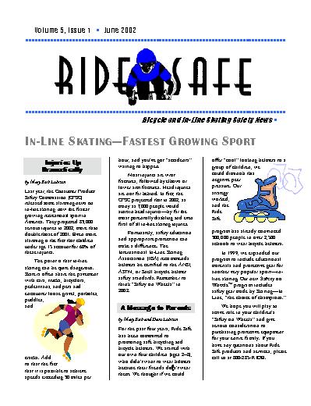
Vocabulary
Newsletter: A periodically published document containing news and announcements about a subject or theme.
Nameplate (Banner): Newsletter’s title, company logo, unique typeface, or graphic image that reinforces organization’s identity.
Folio: Publication information, volume#, issue#, and current date.
Subtitle: Short phrase stating the purpose or audience of the newsletter.
Headlines: Titles to articles – usually 22-74 type size and in sans serif typeface
Folio
Logo
Nameplate
Subtitle
Headline

Slide 13
Vocabulary
Subheads: Secondary headings that provide transition from headlines to body copy (section headings).
Byline: Identifies the author of the article.
Body Copy: Main part of the newsletter text.
Graphic Image: Provides visual clues and visual relief from text-intensive copy.
Page Numbers: Can appear at the top, bottom, or sides of pages. Used to identify where you are in the story/article/etc.
Subhead
Byline
Graphic image
Body copy

Slide 14
Folio
Logo
Nameplate
Headline
Subtitle
Subhead
Byline
Body copy
Graphic image

Slide 15
Nameplate
Also known as a banner, it is what first captures the reader’s eye and immediately identifies the newsletter.
Placed at the top of the first page and occasionally along the left side.
Choice of font or WordArt is important.
Contains the logo: a name, symbol or trademark designated for easy recognition.

Slide 16
Folio
Element consisting of the publishing information that will change from issue to issue, such as the volume number, issue number and date.
Is preceded or followed by a graphic line.
Can appear above or below the nameplate.

Slide 17
subtitle
Emphasizes the purpose of the newsletter and identifies the intended audience.
Usually a Sans Serif typeface, 14-24 size.
Character spacing can be expanded.

Slide 18
headline
Organizes text and helps readers decide whether they want to read the article.
Set apart from text by:
Larger type size
Heavier weight
Different typeface than the body
More space above than below
Reduce line spacing (leading) for headlines of more than one line to improve readability.

Slide 19
subhead
Organizes text and expands on headlines.
Gives readers more information about the text.
Provides contrast to text-intensive body copy.

Slide 20
Byline
Identifies author of article.
Often typed in italic using the same typeface as the body text.
May be the same size as the body typeface, but it may also be set in a type size one or two points smaller.
May appear below the headline or subhead, or as the first line of the body text.

Slide 21
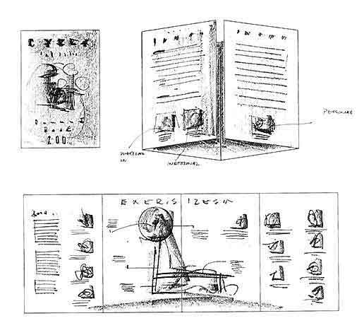
Thumbnail Sketch
Plan the overall look of the document.
Very basic rough sketch used to visualize your design and layout.
To experiment with different layouts and designs.
It’s like “thinking” on paper.
Look at the work of others for hints and suggestions on different layouts.

