Slide 1
Methamphetamine
drugfreeworld.org

Slide 2
History of Meth
First made in 1887 in Germany then resurfaced in Japan in 1919.
Both sides used it in WWII
Keep troops awake, gave to pilots
In the 1950’s used to fight depression and weight gain
Used as a nonmedical stimulant by college students, athletes and truck drivers.
1970’s government made it illegal but motorcycle gains controlled the sale of it
It was cheaper than cocaine and then Mexican drug traffickers set up labs in California

Slide 3
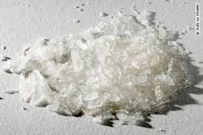
What is Meth?
Many forms of methamphetamine
It is a synthetic drug that attacks the central nervous system
It is in the same class as cocaine
Can take by snorting, smoking, or injecting or orally
Creates false sense of happiness, confidence and energy

Slide 4
Meth and the Body
First acts as a stimulant
Then systematically destroys the body
Causes memory loss, aggression, psychotic behavior, potential heart and brain damage
Highly addictive due to the increased level of concentration
Burns up bodies resources

Slide 5
How it Works
Methamphetamine is very similar to a chemical in the brain called Dopamine.
Dopamine is helpful to the brain in many ways.
It helps control movement, emotional reactions to situations, and it affects the ability to feel pleasure and pain. It helps people feel good!
When someone uses methamphetamine it causes a great flood of dopamine into the brain, which causes the user to feel very high.
But, since methamphetamine is so similar to dopamine, the brain believes it has made enough dopamine and begins to produce less and less.

Slide 6
How it Works
Over time meth depletes (removes) the natural dopamine from the brain, causing the user to feel very depressed.
This is the main reason people continue to use methamphetamine even though it might be causing a lot of problems in their life.

Slide 7
What Does It Look Like
Usually crystal form white powder (ice)
Odorless, bitter-tasting and dissolves in liquid
Other colors of powder: brown, yellow-grey, orange and pink
Can be compressed into pill form
Can be snorted or injected
Names include: chalk, crank, chicken feed, cinnamon, crink, crypto, fast, getgo, speed, tick tick, tweak, wash, blade, cristy, glass, ice, yaba

Slide 8
Stages of Meth
BINGE:
Uncontrolled use
lasts 3-15 days
hyperactive both mentally and physically
Feel aggressively smarter (interrupts people)
keeps using more of the drug until there is no rush or high

Slide 9
Stages of Meth
TWEAKING:
Most dangerous stage
this is the end of the where the drug no longer provides the high
Loses sense of who they are
Feelings of emptiness
Intense itching (bugs crawling)
No sleep
Psychotic state
Hallucinations (vivid and intense)
Hostile and dangerous
Potential self-mutilation

Slide 10
Stages of Meth
THE CRASH
The body begins to shut down
Long periods of sleep
Become almost lifeless
Last 1-3 days
Starved, dehydrated, exhausted physically and mentally
Need drug to feel again
Body needs to be retrained to create Dopamine. Could be depressed for months

Slide 11
Short Term Effects
Loss of Appetite
Increased heart rate, BP and body temp
Dilation of pupils
Disturbed sleep patterns
Nausea
Erratic behavior, sometimes violent
Hallucinations, hyper excitability, irritability
Panic and psychosis
Convulsions

Slide 12
Long Term Effects
Severe tooth decay
Destruction of tissue in nose if sniffed
Breathing problems
Malnutrition
Disorientation, apathy and confused
Psychosis
Depression
Permanent damage to liver, kidney, and lungs
Damage to brain similar to Alzheimer's

Slide 13
Physical Effects
Welts on skin “Meth Acne”
Dry skin
Bleeding of skin
Weight loss
Extreme Swelling
Appears run down
Bad hygiene – body odor, bad breath
Injuries

Slide 14
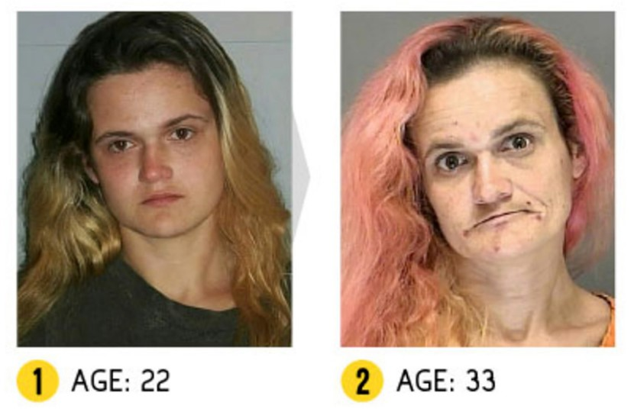
Images

Slide 15
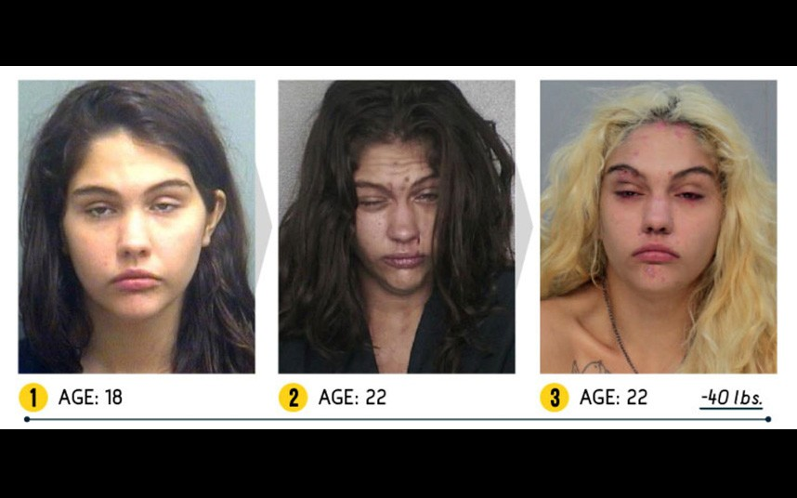
Images

Slide 16
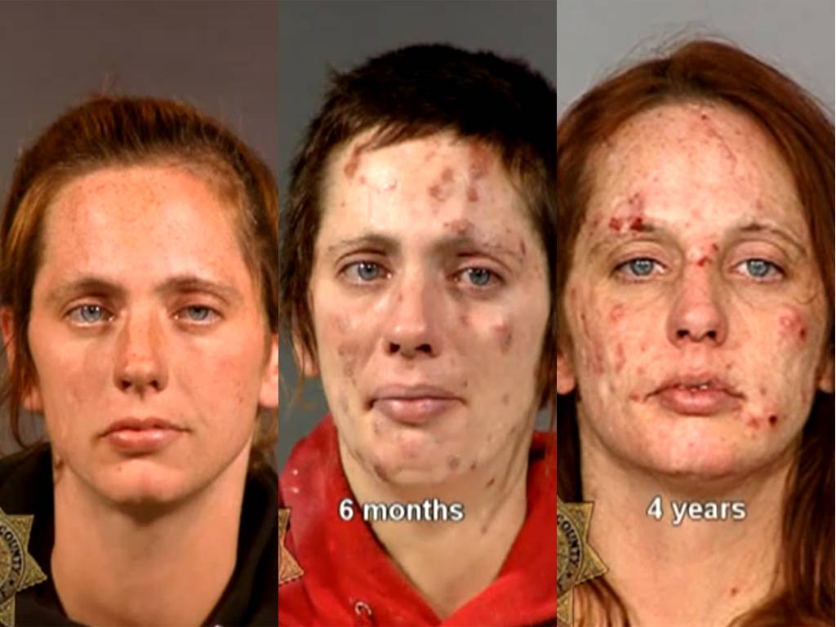
Images

Slide 17
Images

Slide 19
Long Term Effects
Meth causes an increase in sexual appetite, as well as excitement-seeking behavior.
Inhibitions become lowered and promiscuity or sexually unsafe behavior often results.
Compulsive sexuality, often including those outside an individual’s sexual preference, can also be a hallmark of meth use.
Methamphetamines has become notorious for its involvement in the “PNP” (party and play) scene, where anonymous, drug-fueled encounters incorporate methamphetamine use.

Slide 20
Treatment
According to Foundation for a Drug-Free World, 93 percent of those in treatment end up relapsing.
According to a publication titled Methamphetamine Labs, the national rate of meth addiction recovery is between 16 and 20 percent.
Without treatment, a meth addict may live only five to seven years, so it’s imperative to get help soon.

Slide 21
Treatment
Meth addiction is very difficult to treat because of the constant cravings for the drug. The recovery period is very slow, which can be frustrating for meth users.
It can take more than one year for meth users to regain various functions in their brain, including focus and impulse control. Being in a rehab program for an extended period of time – away from the pressures of meth use – can help one regain mental functions more quickly.

