Slide 1
Physical Fitness
and Exercise

Slide 2

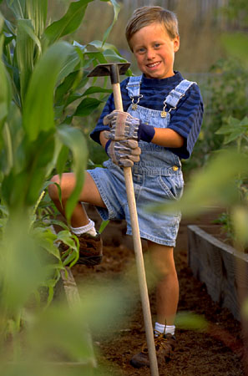
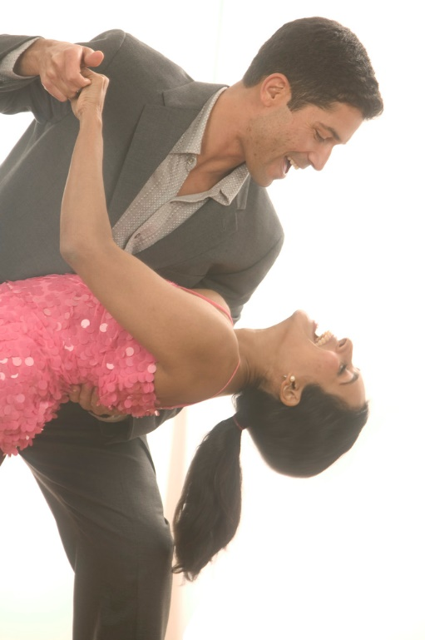
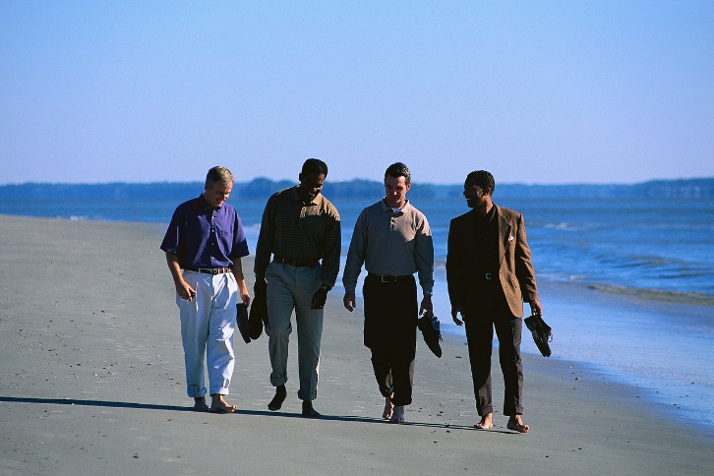
What is Physical Activity?
Anything that gets you moving!

Slide 3
Benefits of Physical Activity
Helps people achieve and maintain a healthy weight
Reduces feelings of stress, anxiety & depression
Builds and maintains healthy bones, muscles & joints
Boosts energy level
Improves quality of sleep
Physical Activity Reduces the risk of
Dying from heart disease or stroke
Developing high blood pressure, cholesterol & diabetes
Developing obesity
Developing osteoporosis – exercise builds strong bones & muscles
Notes:
Regular physical activity can improve health and reduce the risk of premature death in the following ways:

Slide 4
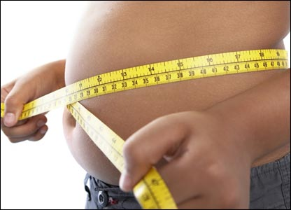
National Trends
64% of adults are overweight in the U.S.
Approximately 30% of adults are obese.
17 % of children ages 6-18 are overweight.
Obesity is the second leading cause of unnecessary deaths.
Consumers spend $33 billion a year on the diet industry.
Every year, about 8 million Americans sign up for weight loss programs that offer a quick fix.
Notes:
A condition in which a person is very overweight and puts one at increased risk for developing major health problems such as diabetes, heart disease, stroke and others.
BMI (Body Mass Index)
BMI between 18.5 and 24.9 is normal
BMI between 25 and 29.9 is overweight
BMI score above 30 is considered obese

Slide 5
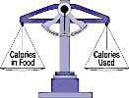
Finding a Balance
Calories in Food > Calories Used = Weight Gain
Calories in Food < Calories Used = Weight Loss
Calories in Food = Calories Used = Weight Control

Slide 6
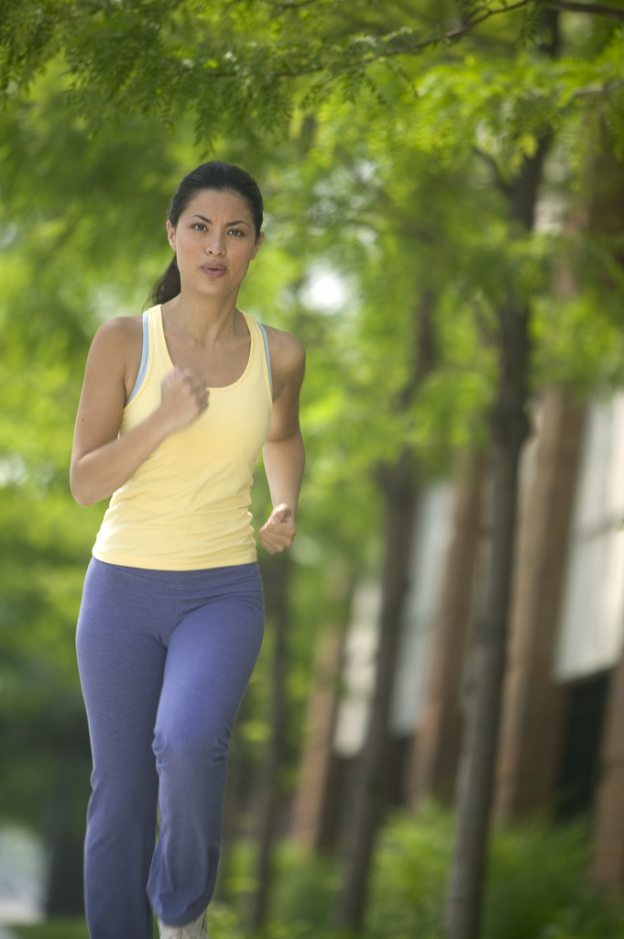
How Much Exercise Do I Need?
U.S. Surgeon General, CDCP, American College of Sports Medicine recommends:
Minimum of 30 minutes
Moderate-intense physical activity
Most days of the week.
Notes:
30 minutes of moderate physical activity on most days of the week – decrease your risk for some chronic disease
60 minutes of moderate to vigorous physical activity to lose weight (keep an eye on foods)
60-90 minutes to maintain after weight loss.
(source http://win.niddk.nih.gov/publications/physical.htm)
(Weight-Control Information Network – USDHHS)

Slide 7
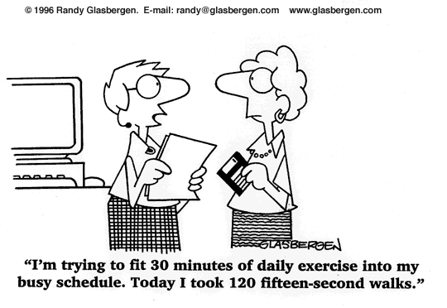

Slide 8
Exercise is Important…
Why Don’t We Do It
I don’t have enough time
I get bored!!
The gym is too intimidating
I Don’t Like It!
I am too tired!!
I don’t know what to do!
I need to take care of the family

Slide 9
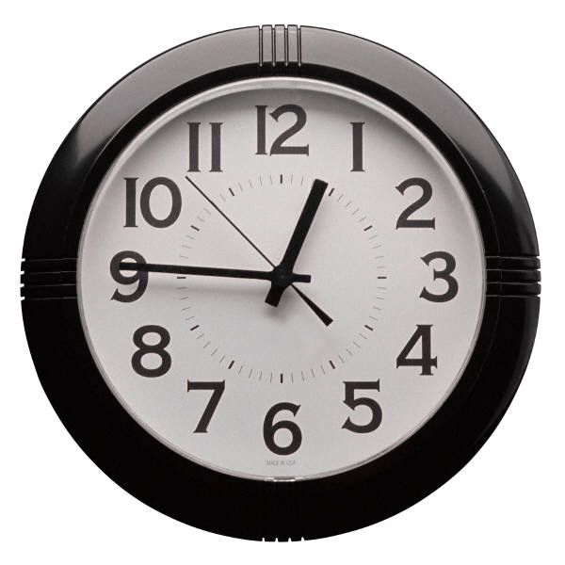
Making Physical Activity a Part of Your Life.
There are 1440 minutes in every day...
Schedule 30 of them for physical activity.

Slide 10
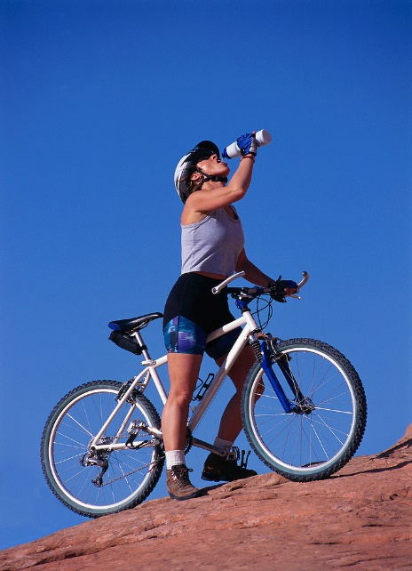
What is Physical Fitness?
Good health or physical condition, especially as the result of exercise and proper nutrition.
Notes:
Fitness refers to the degree of body functioning and the ability of the body to handle physical demands. The more efficient the body functions, the higher the level of fitness. The higher the level of fitness, the greater the chance the body will be free of disease and maintain a healthy state. Fitness is a major part of a preventative medicine approach to health.

Slide 11
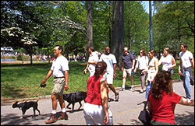
Components of Fitness?
4 Components of Fitness:
  Aerobic
  Muscular
  Flexibility
  Body Composition

Slide 12
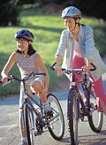
Aerobic Fitness
Defined – The body’s ability to take in and use oxygen to produce energy. Aerobic activities make you breathe hard & they increase your heart rate.
Some of these activities include:
- Jogging
- Walking
- Cross-country skiing
- Bicycling
Notes:
AERO = Air = Oxygen
BIC = Bio = Life Aerobic means "with oxygen" and aerobic exercise is defined as any long duration exercise of low to moderate difficulty using the large muscle groups of the body such as the legs, back, gluteals, arms, etc. When we say "long duration" we mean that in order to achieve the many benefits of aerobic exercise, we must usually sustain this activity for 20 minutes or longer

Slide 13
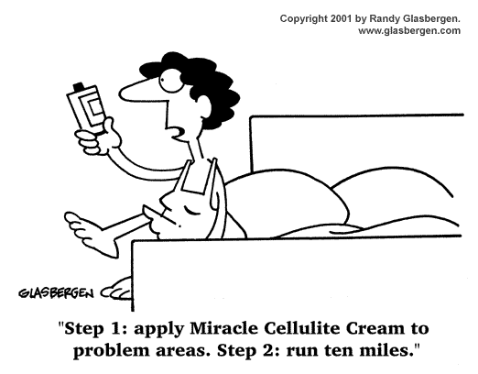

Slide 14
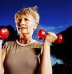
Muscular Fitness
Defined – The strength and endurance of your muscles.
Benefits:
Improve performance
Injury prevention
Improves body composition
Improves self image
Some activities include:
- Weight Lifting
- Push-Ups
Notes:
Benefits of Muscular Strength and Endurance
A. Improved performance of physical activity-If you have a moderate to high level of muscular strength and endurance, you can perform everyday tasks with ease.
B. Prevention of injuries-Increases in muscular strength can protect you from injury by helping you maintain good posture and appropriate body mechanics.
C. Improved body composition-Strength training helps you improve your body composition by increasing lean body mass and decreasing fat.
D. More positive self-image-You look good and feel good as a result of your accomplishments and resulting improvements in your muscular strength and endurance.
Definitions
Muscular strength – the ability to exert maximum force against resistance; 1 RM (Repetition Maximum)
Muscular Endurance – the ability of a muscle to exert submaximal force repeatedly over a period of time
To get stronger – work with heavier weights and perform fewer reps.
To promote endurance – use lighter weights and do more reps.

Slide 15
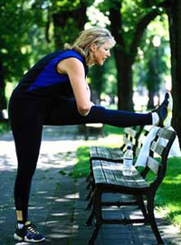
Flexibility
Defined – The ability to bend joints and stretch muscles through a full range of motion.
Some activities include:
- Stretching (Sit & Reach)
- Warm-up & Cool-down

Slide 16
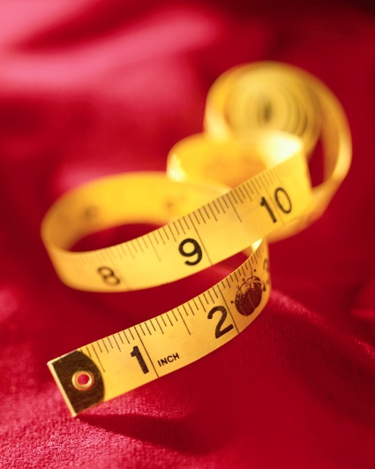
Body Composition
Defined – The amount of fat tissue relative to other tissue in your body.
- Your body composition is based not on how much you weigh, but rather on how much of your weight is fat as opposed to muscle.
Notes:
Excessive body fat can cause musculoskeletal problems and increase your risk of heart disease and high blood pressure.
BMI (Body Mass Index)
BMI between 18.5 and 24.9 is normal
BMI between 25 and 29.9 is overweight
BMI score above 30 is considered obese

Slide 17
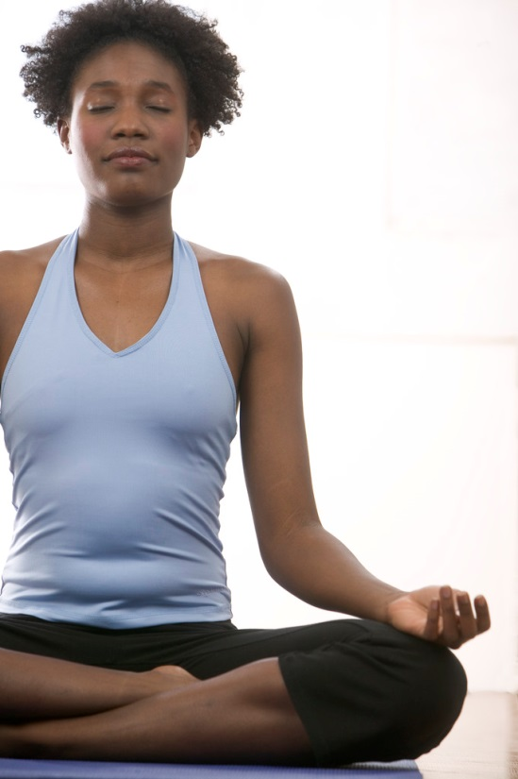
Exercise Your Body & Mind
Yoga, Pilates, Tai Chi
Reduce Stress
Increase strength
Increase Flexibility
Increase Energy
Notes:
Meditation – is the practice of “cleansing the mind.”
AHA recommends meditation as a stress reducer related to heart disease
Yoga. This is a great way to quiet your mind and relax your body. There are different ways to practice yoga--some vigorous and others relaxing. Try this Gentle Stretch workout for maximum relaxation.
Pilates. While more vigorous than some types of Yoga, Pilates forces you to concentrate on what your body is doing while helping you work on core strength, stability and flexibility. This Yoga/Pilates Workout combines moves from both disciplines.
Meditation. Finding the time and patience to relax can be tough. But meditation doesn't have to be complicated--simply stopping to breathe for a few minutes can be your own meditation. Or try Guided Meditation if you're like me and need some direction.
Laugh. Experts have long known the benefits of laughing--it helps your body in a multitude of ways but, mostly, it just feels good. Spend some time with our Humor Guide, which should get you going.
Massage. Schedule a massage in the near future so you have something to look forward to. If that isn't an option, indulge at home with a hot bath or lounging around and reading your favorite book or magazine
www.exercise.about.com

Slide 18
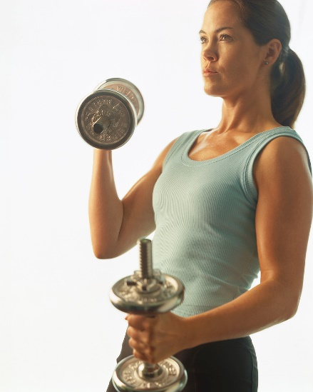
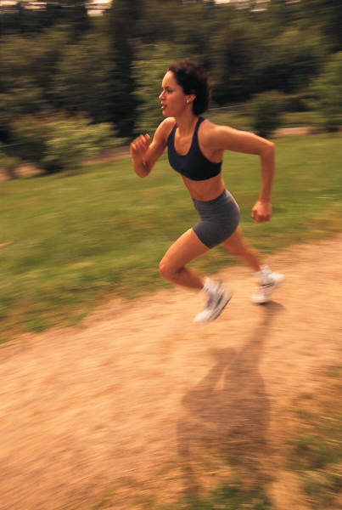
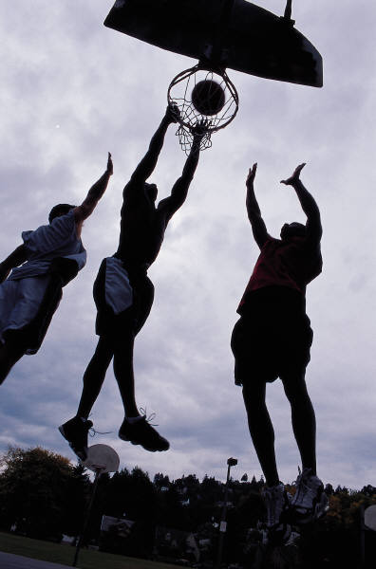
What is the Best Exercise?

Slide 19
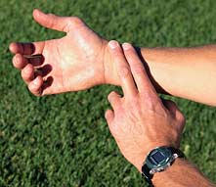
Measuring Physical Activity Intensity – Target Heart Rate
Maximum Heart Rate (MHR)
220 – AGE = MHR
Target Heart Rate
MHR X .60 = Minimum Heart Rate
MHR X .80 = Maximum Heart Rate
Notes:
Target Heart Rate
Generally, to determine whether you are exercising within the heart rate target zone, you must stop exercising briefly to take your pulse. You can take the pulse at the neck, the wrist, or the chest. We recommend the wrist. You can feel the radial pulse on the artery of the wrist in line with the thumb. Place the tips of the index and middle fingers over the artery and press lightly. Do not use the thumb. Take a full 60-second count of the heartbeats, or take for 30 seconds and multiply by 2. Start the count on a beat, which is counted as "zero." If this number falls between 85 and 119 bpm in the case of the 50-year-old person, he or she is active within the target range for moderate-intensity activity.

Slide 20
Target Heart Rate
Are you training at the right pace?
220-36= 184 (MHR) 184 x .60 = 110 (low) 184 x .80 = 147 (high)
My range is 110 – 147 (60-80%) (18 – 24)
Training Zones:
Warm-up Zone: 50-60%
Fat Burning Zone: 60-70%
Aerobic Zone: 70-80%
Anaerobic Zone: 80-90%
Red Line Zone: 90-100%

Slide 21
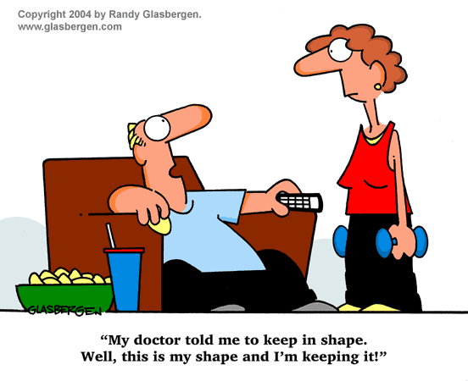

Slide 22
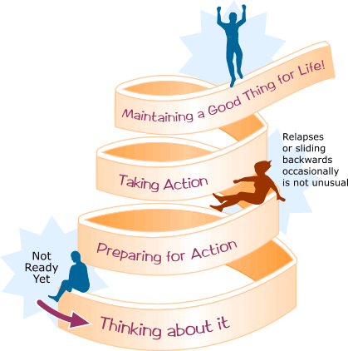
Stages of Change
Notes:
It takes about 3 months to change a behavior and 6 months to make it habit (4women.gov)

Slide 23
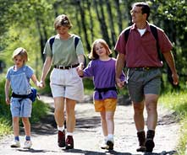
“We are what we repeatedly do.”
— Aristotle

Slide 24
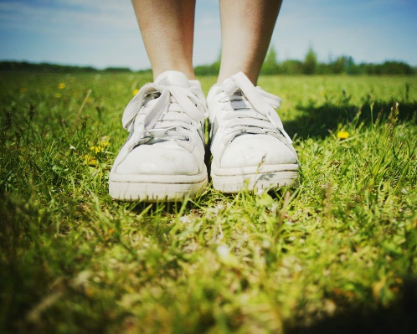
Steps to Fitness
Write Your Personal Fitness Goal
Pre-participation Checklist
Start Moving!

Slide 25
Write Your Personal Fitness Goal
My goal is to ______________________ for at least
(Write one favorite activity here)
__________ minutes ____________ times each week.
(minutes / day) (Number of times)

Slide 26
Pre-participation Checklist
YES NO
Has a doctor ever said you have heart trouble? ___ ___
Do you suffer frequently from chest pains? ___ ___
Do you often feel faint or have spells of severe dizziness? ___ ___
Has a doctor ever said your blood pressure was too high? ___ ___
Has a doctor ever told you that you have a bone or joint problem, such as arthritis, that has been or could be aggravated by exercise? ___ ___
Are you over age 65 and not accustomed to any exercise? ___ ___
Are you taking any prescription medications, such as those for heart problems or high blood pressure? ___ ___
Is there a good physical reason not mentioned here that you should not follow an activity program? ___ ___
**If you answer “yes” to any question, we advise you to consult with your physician before beginning an exercise program.**
Notes:
Hand out a sheet to everyone

Slide 27

Ok, Now What?
Create an Action Plan:
  Decide what you want (your goal)
  Visualize achieving this goal
  Write it down
  Include details
  Reread it often
  Reward yourself
“There is no easy way out. If there were, I would have bought it. And believe me, it would be one of my favorite things.” Oprah Winfrey
Notes:
STUDY: Writing it down: 1953 Yale graduating seniors were asked a series of questions one of which was, “have you established clear, specific goals for your life and have you written them down and made plans to achieve these goals?” Only 3% had. 20 years later in 1973 there was a follow up with the surviving members of the class of ’53 and through this follow up the researchers found that the 3% who had written down their clear, specific goals and had plans to achieve them had more financial wealth than the other 97% combined.
Less than 5% of people have goals. Vast majority of people walking around have no goals at all.
Less than 1% write them down.
Rereading: “golden” times of day 30min upon waking and 30min before falling asleep

Slide 28
Final Tips For Being More Active
Park the car farther away from your destination.
Take the stairs instead of the elevator.
Play with children or pets. Everybody wins.
Take fitness breaks
Perform gardening or home repair activities.
Exercise while watching TV
Keep a pair of comfortable walking or running shoes in your car and office.
Notes:
Adults need recess too! With a little creativity and planning, even the person with the busiest schedule can make room for physical activity. For many folks, before or after work or meals is often an available time to cycle, walk, or play. Think about your weekly or daily schedule and look for or make opportunities to be more active.

Slide 29
Exercise Safely and Wisely
Drink extra water
Always warm-up & cool-down before and after your workout
Wear comfortable clothing
Pay attention to any discomfort you may feel during exercise
Follow your doctor’s recommendations concerning medications you may be taking
Notes:
65% of the human body is composed of water

Slide 30
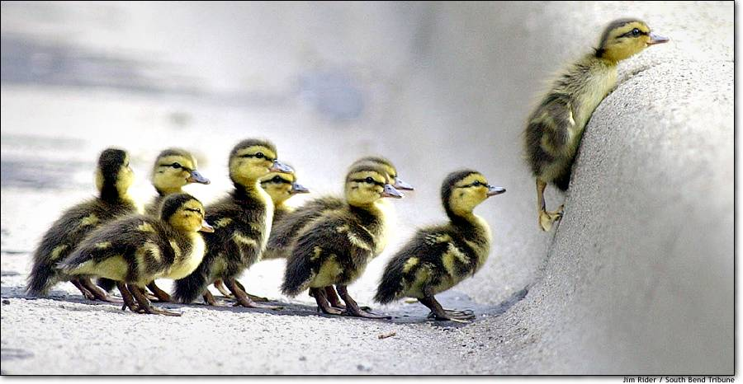
Believe…
…anything is possible!
“The only reason the bumble bee can fly is because no one told him that he can’t!”

