Slide 1
Drug Abuse

Slide 2
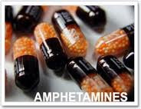
Stimulants
Stimulants are drugs that cause alertness.
Caffeine is the mildest stimulant
Other stimulants such as cocaine and amphetamines are stronger and can be very dangerous.

Slide 3
Caffeine
Naturally occurring stimulant.
Aside from over-the-counter drugs caffeine is found in colas, tea, and coffee.
Absorbed quickly into bloodstream.
Can usually feel its effects within 30 minutes of drinking a 12 oz drink.
Can lead to a tolerance and physical dependence.
Those who attempt to give up caffeine have been known to suffer headaches, irritability, drowsiness and anxiety.

Slide 4
Cocaine and Crack
Cocaine comes in two forms.
Powder cocaine is a hydrochloride salt, made from the leaf of the coca plant.
“Crack” is a smokeable form of cocaine that is processed with ammonia or baking soda and water, and heated to remove the hydrochloride.
Very addictive
Can be sniffed, injected, or smoked
When sniffed the drug enters into the nasal passages and then travels directly to the brain.
Smoking or injecting cocaine allows higher doses to reach the brain faster than sniffing.

Slide 5
Cocaine and Crack
How Many Teens Use Them?
In 2011, a NIDA(National Institute on Drug Abuse)-funded study reported that the following percentages of 8th, 10th, and 12th graders had abused these drugs at least once in the past year:
Powder cocaine: 1.1 percent of 8th graders, 1.7 percent of 10th graders, and 2.6 percent of 12th graders
Crack cocaine: 0.9 percent of 8th graders, 0.9 percent of 10th graders, and 1.0 percent of 12th graders
Methamphetamine: 0.8 percent of 8th graders, 1.4 percent of 10th graders, and 1.4 percent of 12th graders
Amphetamines: 3.5 percent of 8th graders, 6.6 percent of 10th graders, and 8.2 percent of 12th graders

Slide 6
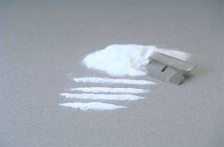
Cocaine and Crack
Cocaine produces a sense of euphoria because it interferes with the reabsorption of dopamine, the chemical messenger in the brain that is associated with pleasure.
The feeling of pleasure last 5 to 10 minutes when the cocaine is smoked and about 20 minutes when it is sniffed.
Cocaine deaths are usually a result of cardiac arrest or seizures followed by respiratory arrest.
The sense of pleasure is often followed by irritability, anxiety, and exhaustion.
These feelings usually last longer than the pleasurable emotions.

Slide 7
Cocaine and Crack
Leads to psychological dependence.
The only way to get the good feeling back is to take the drug again.
It is just as hard to break the mental dependence on the drug as it is to break the physical dependence.
Even if it wasn’t addictive the drug is very dangerous for the body.
Cocaine constricts the body’s blood vessels making it hard for blood to circulate.
This is can cause a heart attack.
This is why you can die with just one use.

Slide 8
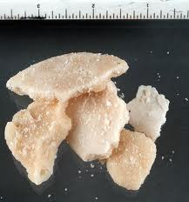
Crack
Crack is cocaine that has been chemically altered.
It is smoked. The cocaine’s base is chemically changed.
When smoked it causes all to increase:
Blood pressure
Heart rate
Breathing
Body temperature
Can cause heart attack like cocaine, also brain seizures, and strokes.
The increase in blood pressure can cause blood vessels to rupture.
Causes hallucinations and violent erratic behavior

Slide 9
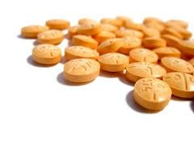
Amphetamines
Synthetic drug – not derived from nature.
Can be prescribed for neurological disorders and life threatening obesity.
Amphetamines, such as Adderall, are stimulants that often come in pill form and are sometimes prescribed by doctors for medical problems, most commonly attention deficit hyperactivity disorder (ADHD).
Amphetamines can also be abused—that is, used in a way other than as prescribed (e.g., crushed and snorted) or used by someone without a prescription.
Can lead to tolerance, psychological dependence and addiction.

Slide 10
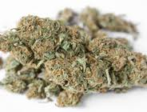
Marijuana
Comes from the cannabis or hemp plant
Marijuana has a chemical in it called delta-9-tetrahydrocannabinol, better known as THC.
A lot of other chemicals are found in marijuana, too—about 400 of them, many of which could affect your health.
But THC is the main psychoactive (i.e., mind altering) ingredient.
In fact, marijuana’s strength or potency is related to the amount of THC it contains. The THC content of marijuana has been increasing since the 1970s. For the year 2007, estimates from confiscated marijuana indicated that it contains almost 10 percent THC, on average.

Slide 11
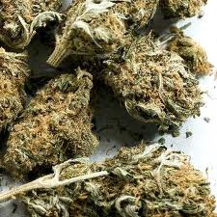
Marijuana
THC interferes with learning and memory—that is because the hippocampus—a part of the brain with a funny name and a big job—plays a critical role in certain types of learning.
Disrupting its normal functioning can lead to problems studying, learning new things, and recalling recent events.
Can become psychologically dependent on the drug
Causes loss of coordination and poor judgment
Causes a person to feel anxious or paranoid
Contains toxins that can damage:
Lungs
Reproductive system
Immune system

Slide 12
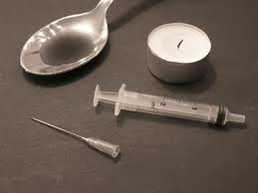
Heroin and Narcotics
Narcotics – made from the opium poppy plant
Useful for medical purposes
Relieve pain: Codeine and Morphine
They are the most physically addictive drugs
Need to follow doctors orders
Heroin is a powerful narcotic that is illegal to buy sell or use
People who are addicted to heroin have to keep increasing their doses
For this reason the overdose is a risk

Slide 13
Treatment
How Addiction Treatment Works
A person who is addicted to drugs needs to follow a treatment approach that includes a detox phase first. This is the part of the program where the addict’s body gets rid of the drugs. Withdrawal symptoms that the addict will experience during this time include cravings, sleep disturbances, body aches and pains, increased appetite and irritability.
This phase of the addiction treatment should be supervised by people who are knowledgeable about this form of addiction and can monitor the addict’s condition during the process.
This phase can last for up to 14 days, depending on how long the person used the drug and how much of it they were ingesting.
Once the drugs have left their system, the addict needs to go to a rehab facility or a center that specializes in treating addiction to complete the treatment process and put them on the road to recovery.

