Slide 1
Design concepts and selection tools

Slide 2
CONTRAST
Contrast can be defined as “the difference in visual properties that makes an object (or its representation in an image) distinguishable from other objects and the background.”
Contrast is greatest for close objects. Distant objects have less contrast in them and less to their surroundings.

Slide 3
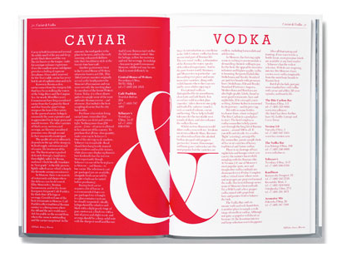
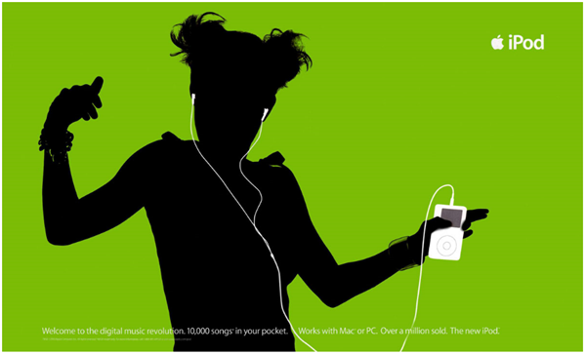
COLOR CONTRAST
Bright, vibrant colors over black background

Slide 4
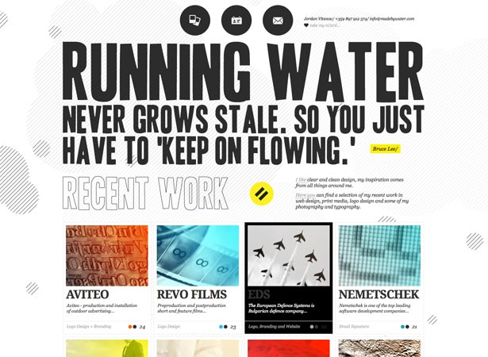
SIZE CONTRAST
The size of important elements in relations to the rest of the page can set them apart nicely. This can be done with large typography, graphical elements or call to action buttons.

Slide 5
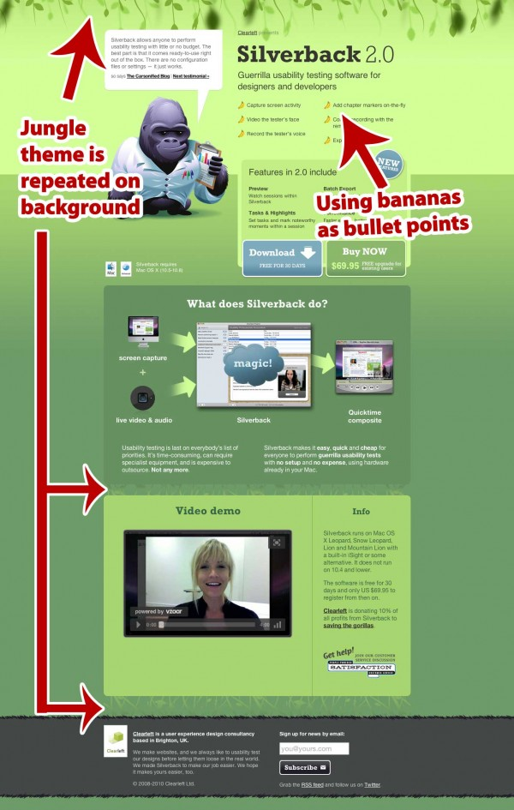
REPETITION
Just choose a color, a shape, a pattern, or a technique, and repeat it one or more times on a layout. It’s really that simple.
The concept of repetition says that you repeat design elements throughout the entire piece. The element can be a font style, graphic, line, icons, colors, the list is endless.

Slide 6
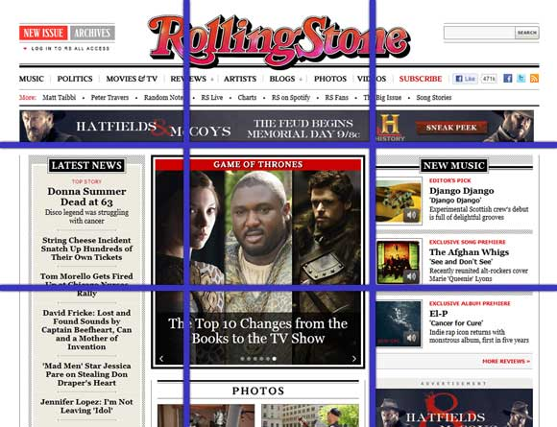
PERSPECTIVE
Using the rule of thirds can also help determine placement of objects, especially when adding in additional images.
Horizon line: Every photograph has a horizon line that represents the level of the camera that took the picture. The horizon lines for all of the picture parts in your photomontage must be on the same line

Slide 7
PERSPECTIVE
Design concept that gives an illusion that there is depth to an object.
The horizon line is a theoretical line that represents the eye level of the observer.
The horizon line is the same as the horizon (the edge of the land against the sky) only on a large flat plane like the ocean.
Most of the time geographic features (hills) and other objects (trees and buildings) make the horizon above the horizon line.
Adjusting the size or placement of the objects can give the viewer a feel of depth.

Slide 8
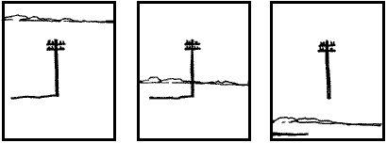
PERSPECTIVE – CONT.
Look at the three sketches below. The same telephone pole is in the same position in all of the formats.
The horizon (line) is different. Can you tell where you are in relationship to the poles?
The first pole is seen from above, the second from normal eye level and the third appears to be floating over your head.
An object's relationship with the horizon line shows whether you are looking up, down or straight at the object.

Slide 9
SELECTION TOOLS
Subtract from Selection: if you want to remove a portion from the selection.
Anti-alias: this helps with blending. It helps reduce the stair step look on a cut image.
Feathering: softens the edges of a selection by feathering it, or blurring the edges.
Inverse: choosing the opposite area of the selection.
Refine Edge: options to change the borders of your selection.

Slide 10
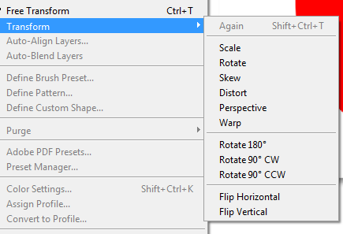
MOVING SELECTIONS
Transform controls: size handling bars
Bounding box: border with size handlings around a selection.
Reference point: displays the center of the image. You will then have options available in the transformation mode.
Transfer Mode:
Scale
Skew
Rotate
Distort
Warp
Perspective
Flip Horizontal/Vertical

