Slide 1
Dating and relationships

Slide 2
dating
Parents don’t want dating to interfere with their teens’ emotional, social, and psychological development.
Early dating may interfere with the development of an independent sense of identity.
Teens who begin dating at a young age and form steady relationships are more at risk for becoming sexually active.
You should set some standards for yourself.

Slide 3
Dating skills checklist
Know where your going and with who before you accept
Decline the date if you feel pressured - feel like you might be pressured to do things you are uncomfortable with
Don’t change plans if something else/better comes along
Recognize the benefits of dating different people rather than going steady
Have a plan to leave if things get out of hand
Be honest and kind when you turn down someone for a date

Slide 4
Use resistance skills
Be confident and say “No, you don’t want to be sexually active.”
Avoid being around those who pressure you to be sexually active
Use non-verbal behavior to support message
Avoid situations that put you in an uncomfortable situation
Know the laws
Love doesn’t pressure
You don’t owe anybody your body
Don’t be pushed by guilt

Slide 5
Recognize harmful relationships
Your health is connected to the quality of relationships you have.
Relationships are usually healthy or harmful
Healthful Relationships: promotes self-respect, encourages health, and is free of violence and abuse.
Harmful Relationships: harms self-respect, interferes with your health, includes violence and abuse.
Some people lack self-respect. They don’t care about the emotional health of others. They don’t encourage others to be their best, they bring them down or keep them from be successful in their life.

Slide 6
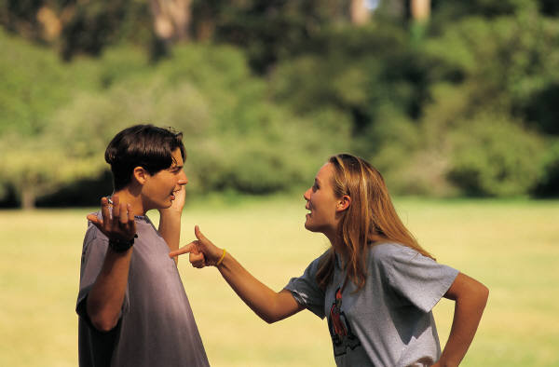
Ten profiles of people who relate in harmful ways
The people pleaser:
constantly seeks approval of others
Will do anything to be liked, tends to be a doormat
The enabler:
supports harmful behaviors of others
Makes excuses for the behavior, denies his/her feelings
The clinger:
Person is needy and dependent
Suffocates others
The fixer:
Attempt so fix others problems
Quick to give advice
Take over other people’s responsibility
The distancer
Emotionally unavailable to others
Avoids sharing feelings, keeps others at arms length

Slide 7
Ten profiles of people who relate in harmful ways
The controller:
Possessive, jealous, and domineering
Does not respect others, demands their way
The center:
Self-centered “Me, Me, Me”
Talks, but doesn’t’ listen, ignores others
The abuser:
Puts down others, threatens, harms them, abusive language
The liar:
Builds relationship on lies, manipulates others into the responses s(he) wants
The promise breaker:
Not reliable, makes plans and breaks them
Claims will change, but doesn’t

Slide 8
Harmful relationships combined
Promise Breaker + People Pleaser
People pleaser accommodates the promise breaker, puts feelings aside
Need to set limits, and keep commitments
Controller + Enabler
Angry outbursts, jealous of friends, places rules, enabler provides excuses, convinced there is a reason for the behavior.
Should trust and buildup loved ones, the enabler should not deny feelings
Clinger + Distancer
Clinger typically comes from a divorced family, afraid to be vulnerable and close. The distancer is emotionally unavailable. They play each others game.
Clinger needs to address emptiness and develop self-confidence, and the distancer needs to share feelings of why they feel they can’t get close

Slide 9
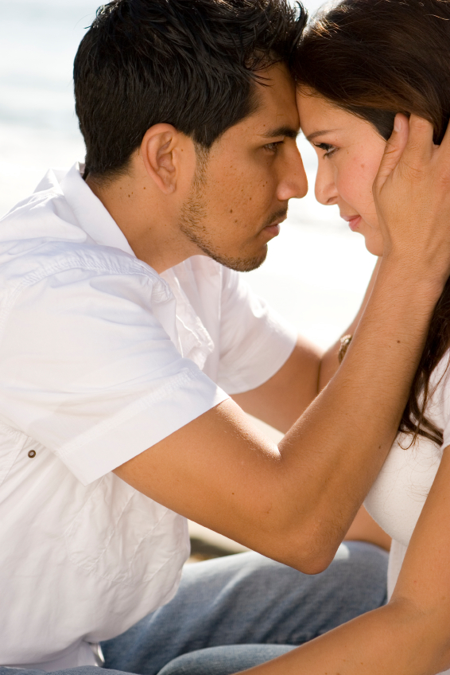
What to do…
Evaluate your relationship on a regular basis
Recognize when you must end a harmful relationship rather than work to change it
Focus on what is wrong and make a choice to change it
Talk to someone about it
Be upfront with your partner
Set a checkpoint on your progress

