Slide 1
Contrast
Principles of Design

Slide 2
What is contrast?
Contrast occurs when two elements (fonts, color, size, etc.) are different
The greater the difference, the greater the contrast.
“If two items are not exactly the same, then make them different. Really different.”
Contrast adds interest to the page and provides a means of emphasizing what is important or directing the reader’s eye (organization).
On a page without contrast, the reader doesn’t know where to look first or what is important.
Contrast makes a page more interesting so the reader is more apt to pay attention to what is on the page.

Slide 3
How do you achieve contrast?
Four common methods of creating contrast are by using differences in size, value, color and type.
Value refers to the lightness or darkness of a color
Use different fonts, colors, alignment, shapes and images on a page.
The key to working with contrast is to make sure the differences are obvious.
For contrast to work successfully, it must be strong and obvious. It needs to make an impact.
Be aggressive and make the contrast stand out!

Slide 4
A powerful design concept
Any design element can be contrasted with another.
You can achieve contrast in many ways
Manipulate space (near and far, empty and filled)
Color choices (dark and light, cool and warm)
Text selection (serif and sans serif, bold and narrow)
Positioning of elements (top and bottom, isolated and grouped)

Slide 5
Contrast simply means difference
There is no set rule for how to create contrast. The goal is just to make a visual splash where parts of the page stand out.
There are two main purposes of contrast:
Create interest on the page
Aid in the organization of the information

Slide 6
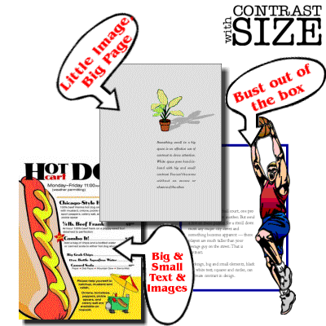
Contrast with size
Big and small elements of the same type, such as big and small images and big and small type are the most obvious uses of size to create contrast.
Contrasting white space or the physical size of the piece with another element of the design is another method.

Slide 7
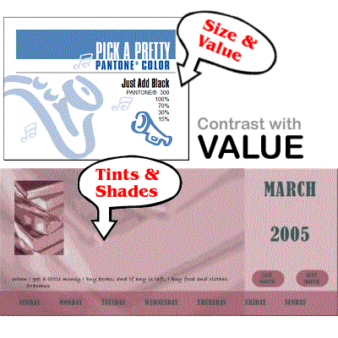
Contrast in value
The relative lightness or
darkness of two elements
to each other can create
a contrast in value.
Whether with shades of
gray or tints and shades
of a single color, the
further apart the values,
the greater the contrast.

Slide 8
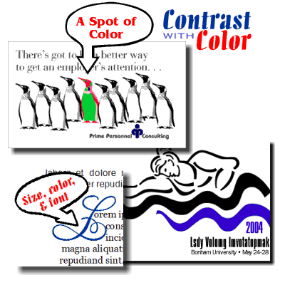
Contrast with color
http://www.sitepoint.com/principles-of-design-contrast/
Use harmonizing, complementary, and opposite colors to create contrast.
Be careful with the value of the colors as well.
For example, harmonizing colors (adjacent to each other on the color wheel) can appear washed out if there is not enough difference in the values of each color.

Slide 9
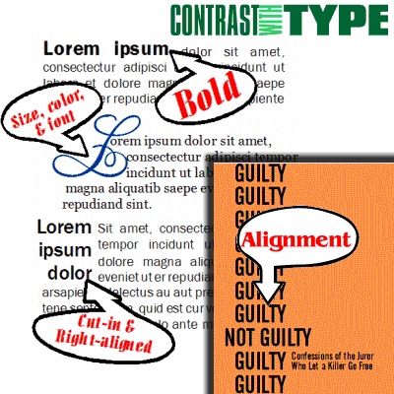
Contrast with type
Type contrast can utilize size, value, and color to create contrasting typographic treatments.
Add bold or italics
Mix large type with small type.
Combine serif with sans serif type
Set portions of text in contrasting colors or varying values.
Change type alignment or type spacing (example—kerning)

Slide 10
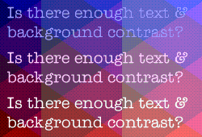
Other methods of contrast
Texture
Shape
Alignment
Direction
Movement
The key is to use a substantial difference
A bold face, a font size change that is barely noticeable, and colors that are too close in value looks more like a mistake than an attempt to provide emphasis or interest.

Slide 11
Design with bold type
Use bold for emphasis to highlight important points. Don’t overdo it.
Avoid setting entire paragraphs in bold as it is harder to read.
The reason that bold type creates emphasis is that it slows down the reader and forces their eye to really take in the words more carefully. If you slow them down too much, they may just skip over what you have to say.
Create contrast for headlines and subheadings

Slide 12
Use bold effectively
Avoid the temptation to use boldface text to emphasize words within a passage of text. Bold text is like a magnet to our eyes, and if used incorrectly, ruins the continuity of your text.
Set key terms or phrases in bold to aid in scanning text to find important information quickly.

Slide 13
In review . . .
Contrast on a page draws our eyes to it; our eyes like contrast.
If you are putting two elements on a page that are not the same, don’t make them similar . . . for contrast to be effective, the two elements must be very different.
Contrast creates interest and aids in organization of a page.
If you are going to do contrast, do it with strength.

